Slide 1
Filter Bubbles
Nick Feamster

Slide 2
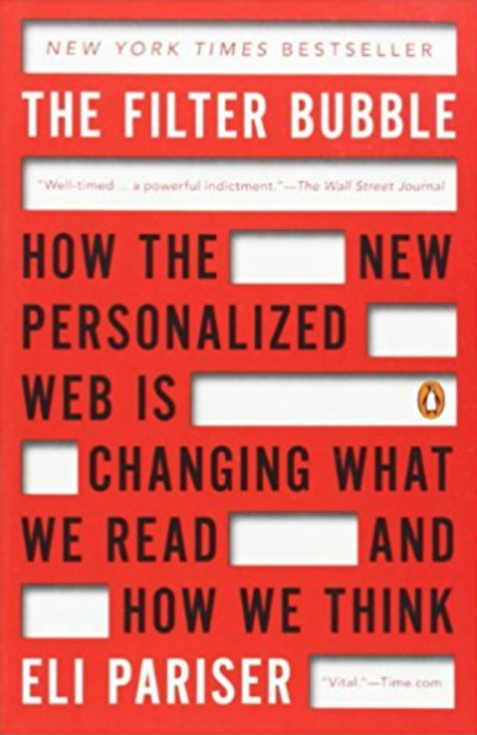
Notes:
May 2011

Slide 3





Personalization as “Filter Bubble”
“A squirrel dying in front of your house may be more relevant to your interests right now than people dying in Africa.”
– Mark Zuckerberg
Online personalization is creating situations where we only see things that already suit our own tastes.
Personalization can also be exploited.

Slide 4
Motivation
Search engines deliver inconsistent search results
These inconsistent results may sway searchers’ opinions or judgment to products or political events etc.
Notes:
Over the past few years, the personalized search technique is largely deployed on different search engines.
It incorporates a user’s individual information, tailors user’s search experience, and presents inconsistent search results to different users. However, …

Slide 5
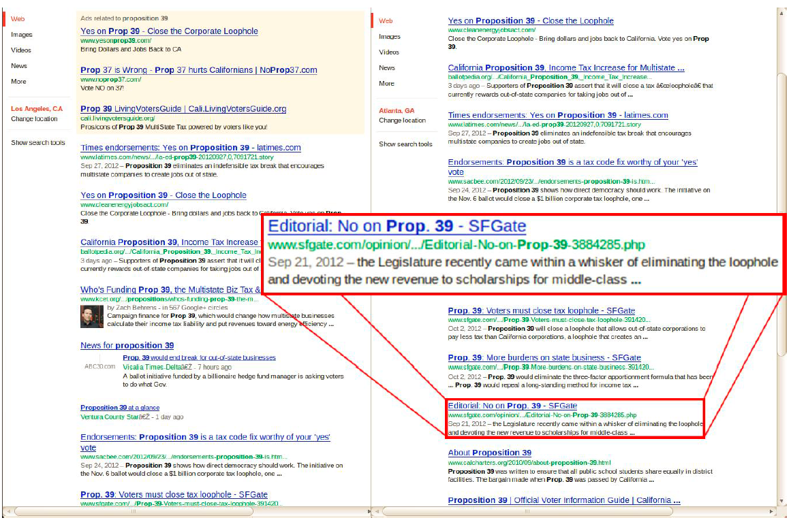
Proposition 39
From California
From Georgia
Notes:
Here is another example. I did the similar study from the same regions at the same time.
In particular, I searched a California ballot proposition before the voting actually took place in Oct. of 2012.
The tone of the search results from CA was overwhelmingly positive toward the proposition that CA should close an unfair corporate tax loophole.
But, the tone of the result set from GA was kind of mixed. It not only contained the results positive toward the proposition, but also the results negative toward it.

Slide 6
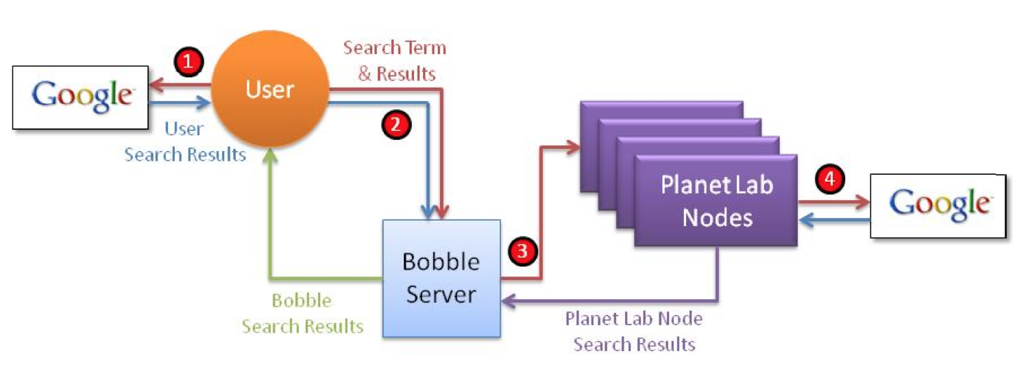
Bobble: Bursting the Filter Bubble
Execute query
As different users
Different vantage points
With different history (e.g., cookies)
Compare differences in results
What shows up on the first page?
Where does it show up?
When it doesn’t appear, what are the possible explanations?

Slide 7

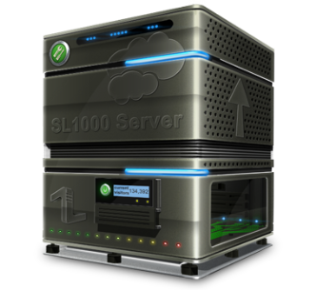



Bobble Architecture
Search term
Search term
Search results
Search results
Bobble User
Search term
Search term
Search results
Search results
Bobble Server
Notes:
… bobble users who install our browser plugin; bobble server that collects data from user and search engine; search agents that run on hundreds of PlanetLab nodes
Our Bobble works in the following way.

Slide 8
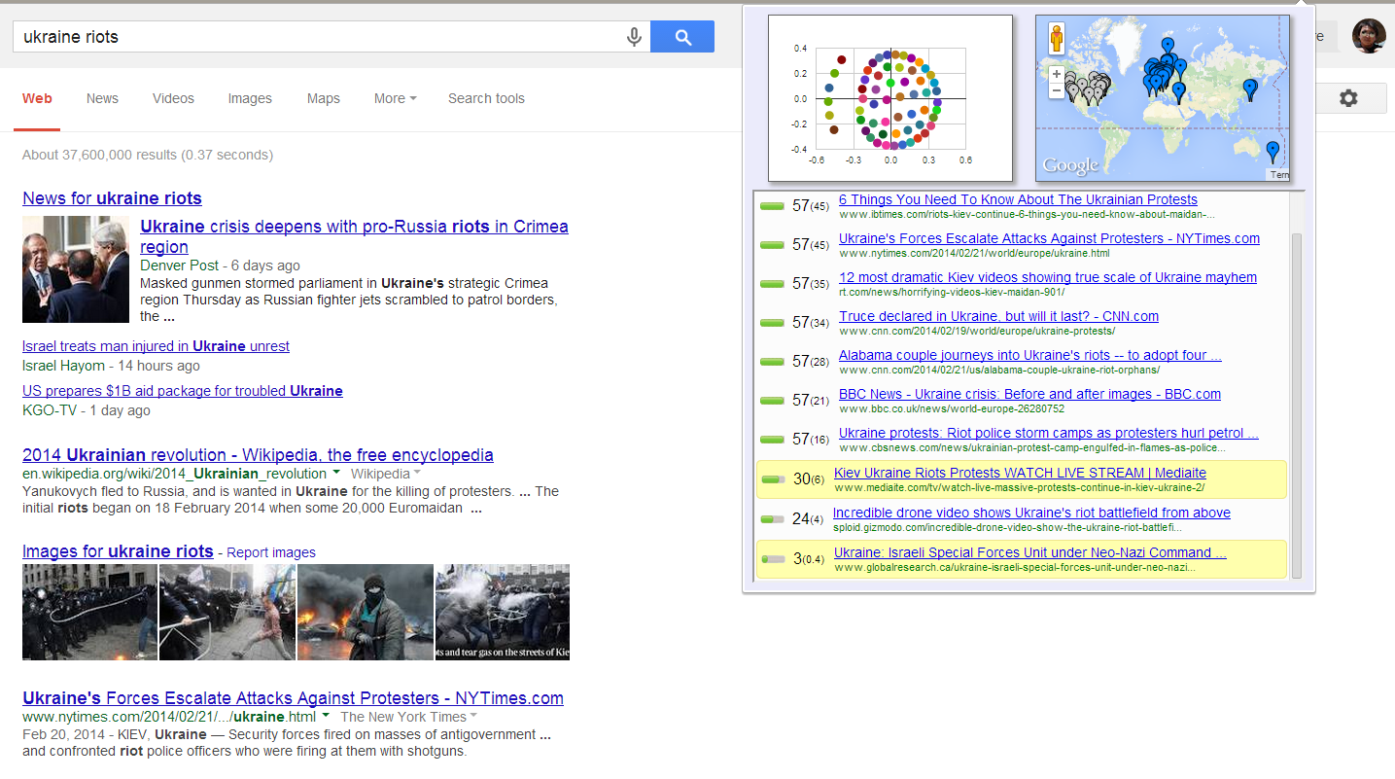
User Interface of Bobble
Notes:
This is the user interface of bobble.
First, it ranks and shows all the search results from PlanetLab nodes.
Second, it highlights the results that don’t appear in a user’s results.
Third, it shows where the results come from
Last, it also uses a similarity measure to project the different search result sets into a 2-dimensional space.

Slide 9
Questions
Can we expose search inconsistencies?
What is the nature of inconsistencies?
Notes:
After seeing these impressive phenomenon, there are so many questions coming up in our mind. For example, we may ask
How serious this phenomenon is across a wide spectrum of search terms?
If proposition 39 has been passed? And
How Google react to these phenomenon? And so on …
Here, I can answer you a few … For example, I can tell you proposition 39 has been passed!
But, in this talk, I’m not gonna focus on these questions. Instead, I will devote all my energies on two prerequisite questions that are relevant, crucial and tempting.

Slide 10
Roadmap
Browser plugin, Bobble (http://bobble.gtisc.gatech.edu/)
allows users to see how the search results that Google returns to them differs from the results that would be returned to other users distributed around the world
Collect the user’s search query and results
Study how users’ Google search results vary based on their geographic locations and past search histories (user profile)
Notes:
So, in his talk, I will first introduce a tool – a browser plugin, Bobble.
Second, I will talk about how we use Bobble to collect ...
Finally, I will use our collected data and study …

Slide 11
Requirements for Data Collection
Effects of user profile
search results of Google users
customized based on user profiles
not influenced by profiling (organic result)
Effects of geography
Organic search results from different regions
Notes:
As I mentioned beforehand, one of our goals is to understand the nature of search inconsistencies. So, we need to use bobble to collect data.
First, we collect two sets of data to study the effects of user profile. From the same location, we collect a user’s search results tailored by his user profile. Also, we collect the user’s organic search results independent on his profile.
Second, we get rid of the impacts of user profile, and use Bobble to collect organic search results from different regions.

Slide 12
Results Customized by User Profiles
Google profiles users according to
signed-in sessions
signed-out sessions with cookie enabled
Collect search results when
Google users sign in
Google users sign out (with cookies enabled)
Notes:
Getting the results tailored by user profile is less challenging. Google profile users when they login their Google accounts or enable their Google cookies, so our browser plugin sends users’ results to our Bobble server when it sees the users logged in or enabled their coockies.

Slide 13
Statistics
From 2012/1/17 – 2012/10/25 (9 months)
174 distinct Google-user installation
76,307 queries
66,138 queries issued by signed-in users (86.67%)
10,169 queries issued by signed-out users (13.33%)
Notes:
Here are some statistics about our deployment and our dataset.

Slide 14
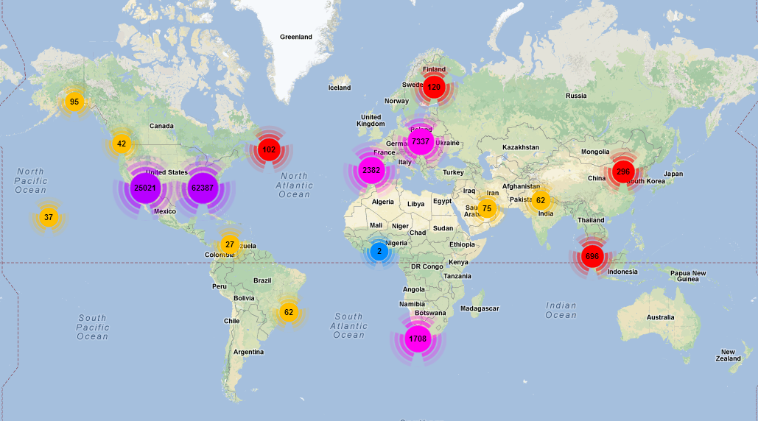
Geographic Distribution of Queries

Slide 15
Effects of Geography
Compare a user’s organic result set with organic search result sets (from different regions) in regard to
# of search results
rank
title
url
Notes:
We study the effects of geography on search inconsistencies. In particular, we …

Slide 16
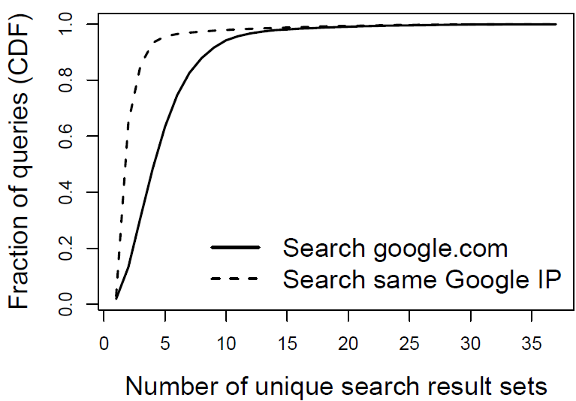
(~3, 80%)
(~6, 80%)
97.76% queries generate
at least one inconsistent
set of results
Data center inconsistency
causes inconsistent search
(2) PageRank scores might be
Inconsistent over different regions
(1, 2.24%)
CDF plot: The distribution of # of search queries
Notes:
…
Also, we find # of inconsistent result sets is significantly reduced when users send their search terms to a specific data center rather than google.com. This basically means the data center inconsistencies are large within Google data centers. So, these inconsistencies cause our search inconsistencies.
In addition to that, we also find geographic location alone still causes search inconsistencies, because there are still approximately 98% queries having more than one set of inconsistent results. And we believe this is because …

Slide 17
Effects of User Profile
Compare organic result set with result set customized by user profile in regard to
# of search results
rank
title
url
Notes:
We also quantify … in particular, we compare a user’s organic result with the result tailored by user profile

Slide 18
Summary of Inconsistencies (Effects of Geography)
Not in user’s result set, but in Google top 3 elsewhere: 30.66%
Not in user’s result set, but in Google top 10 elsewhere: 86.41%
At least one result appears in Google user’s result set but does not appear at other PlanetLab nodes: 1.88%

Slide 19
Summary of Inconsistencies (Effects of User Profile)
Not in user’s organic result set, but in Google top 3 elsewhere: 30.66%
Not in user’s result set, but in Google top 10 elsewhere: 86.41%
At least one result appears in Google user’s result set but does not appear at other PlanetLab nodes: 1.88%

Slide 20
Comparison
 | Signed-in dataset | Signed-out dataset
Profile influence on inconsistency | 64.19% | 58.77%
User profile has less effects on inconsistencies than geographic location (~97% vs. ~60%)
Signed-in profile has slightly more effect on inconsistency than signed-out profile
Notes:
Here is the first comparison …

Slide 21
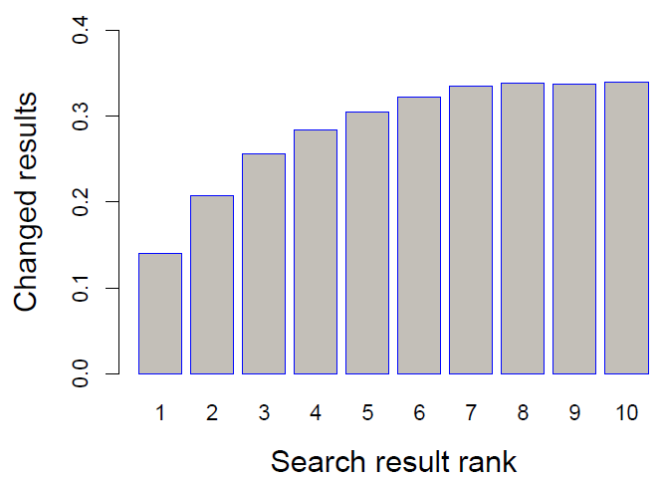
Comparison (cont.)
% of search results changed at each rank in our dataset is 28% on average.
Hannak et al. report this measure: 11.7%

Slide 22
Conclusion
Search inconsistency is pervasive
Geographic location introduces inconsistency in about 98% of queries
User profile results in addition or removal of results more than 60% of the time
Next steps
More detailed study of how other factors affect results
More detailed analysis on how inconsistent results may sway public opinions

Slide 23

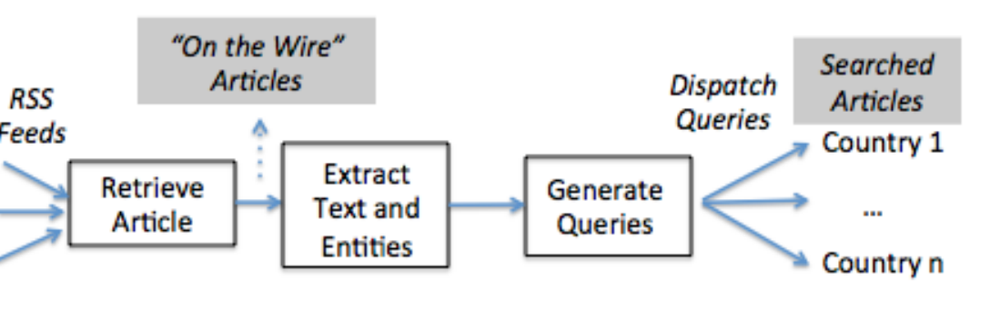
Happens for News, Too…
20% of news sources responsible for 80% of articles
Local sources ranked higher
8,000 queries returned a result in one country but zero results in at least one other country

Slide 24
What about bad inputs?

Slide 25




Pollution Attack
Pollution attack targets recommender systems:
Personalized search
Video & product recommendation
Intelligent ad network
Input
Recommendation
algorithms
Output
Notes:
This attack targets intelligent systems like personalized search, video recommendation, and intelligent ad networks.
It attacks the input of these systems.

Slide 26








Pollution Attack
pollution attack
Bob
Most relevant
content
False content
Fake Browsing behaviors
Browsing behaviors
Database
User computer
Preference profile
Recommender system
Notes:
Before I talk about this attack, let’s quickly look at how these intelligent systems work.
First, these intelligent systems take a user’s browsing behaviors as input, and create a preference profile…..
As I just said this attack targets the input of intelligent system. And, here the input is the browsing behavior.
So, the attack picture becomes more clear. … first, the attacker use some fake browsing behaviors to pollute the preference profile. Because intelligent system uses the preference profile to make decision, the intelligent system will pick the false content and return it to the user.

Slide 27
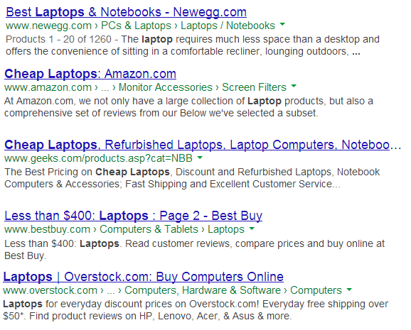

Pollution Attack on Search Engine
Rank 1st
Rank 6th
Notes:
The pollution attack can be used for many purposes.
First, it can be used for business promotion.
Assume I am selling “laptops” on my website and I would like to increase the visibility of my website. So I want it rank on the top on Google because higher rank can bring me a large number of visitors.

Slide 28
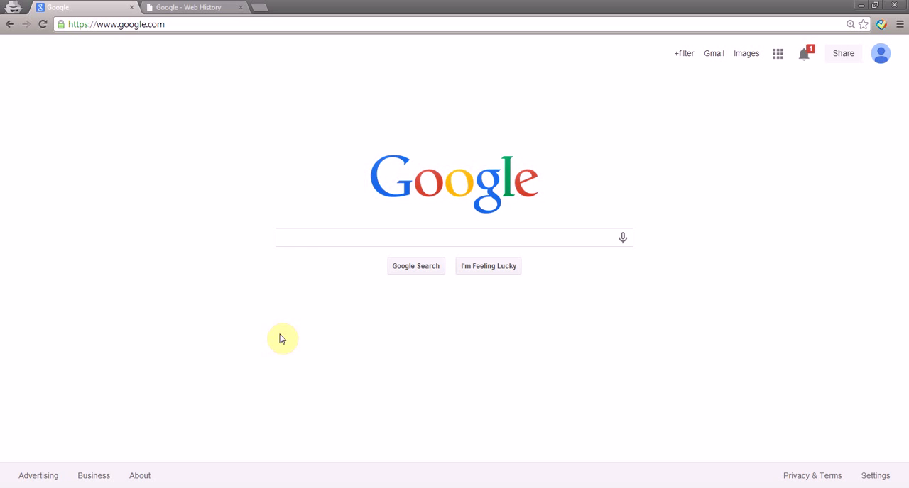
Pollution Attacks
Take This Personally: Pollution Attacks on Personalized Services. X. Xing, W. Ming, D. Doozan, A. Snoeren, N. Feamster, W. Lee. In USENIX Security Symposium, 2013.

